Slide 1
StudentScrap Web Application
GitHub Repository: https://github.com/rusafabrahat/studentscrap-app

Slide 2
Purpose of the Web App
• A moodboard for students
• Makes a a scrapbook page with PNGs and short texts
• Makes task visually expressive and memorable

Slide 3
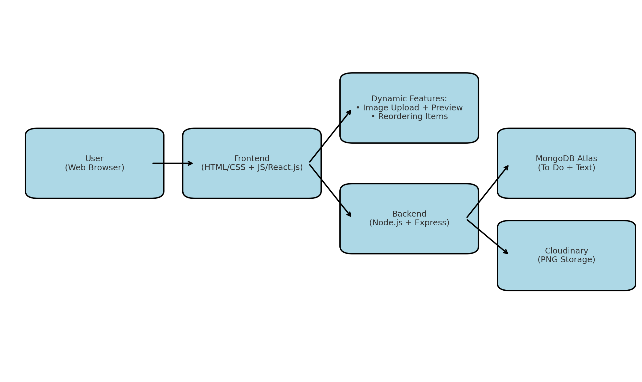
Architecture Diagram
See embedded diagram below.

Slide 4
Technology Choices
Frontend: HTML, CSS, JavaScript / React.js
Backend: Node.js + Express.js
Database: MongoDB Atlas
Image Hosting: Cloudinary

Slide 5
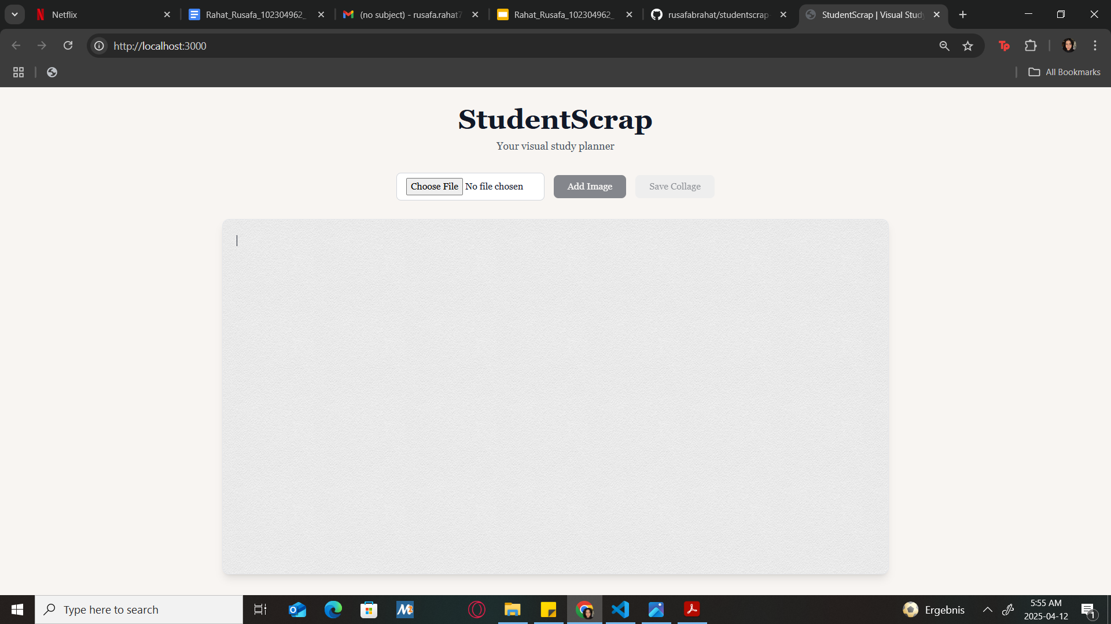
Screenshot - Homepage / Task View
User sees the option to upload an image and add it.

Slide 6
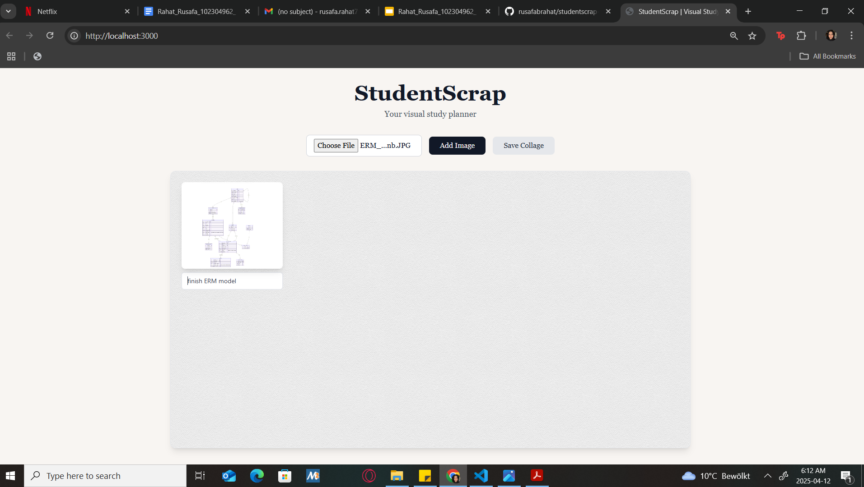
Screenshot - Scrapbook Page
Each to-do item is composed of a PNG and short text to be visually arranged.

Slide 7
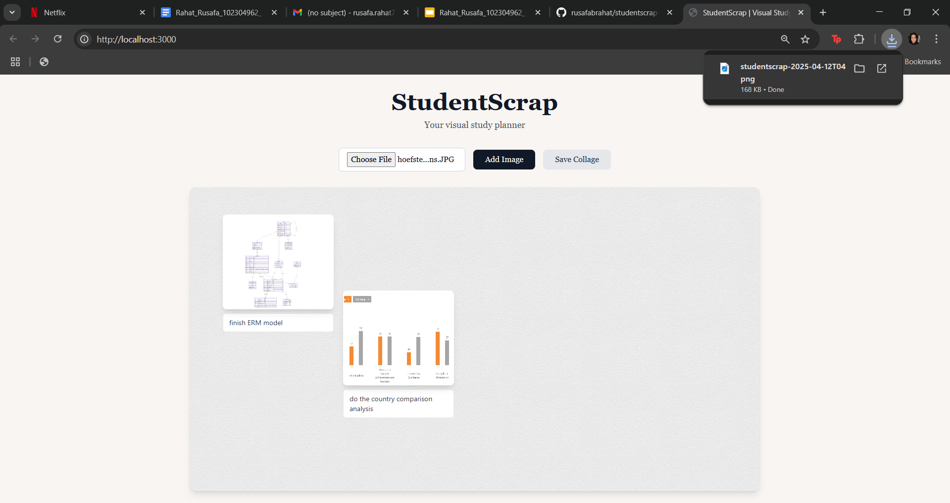
Screenshot - Download Collage
Users can save/download the collage to their localStorage after they are finished..

Slide 8
Reflection - Changes Made
• Added html2canvas and dompurify for collage download and switched to React.js for better state handling
• CORS configuration
• Skipped authentication to focus on core visual layout features
• JPG image types are also now included
• Drag and drop changed to react draggable

Slide 9
Challenges & Solution
CORS Issues: Fixed with proxy routes
Image Persistence: Used localStorage as fallback
PNG Export: html2canvas + Cloudinary CORS config

Slide 10

Screencast Video
App flow in the screencast video below. (https://drive.google.com/file/d/1Q76Xxr-Y-IrCG8Vb02z_I3eKWN_wRrMv/view?usp=sharing)

